Slide 1

COSI 104a Introduction to Machine Learning
Chapter 18 – Outlier Detection
 | Instructor: Dr. Hongfu Liu Email: hongfuliu@brandeis.edu
The class notes are a compilation and edition from many sources. The instructor does not claim intellectual property or ownership of the lecture notes.

Slide 2

What is outlier detection
The samples that deviated from others are regarded as outlier candidates

Slide 3
Application
Fraud detection (credit card, telecommunications, criminal activities)
Medical Treatments
Financial Applications (loan approval, stock tracking)
Alarm

Slide 4
Causes of Outliers
Data Collection (wrong data, failure of sensors)
Low quality measurements
Correct but exceptional data

Slide 5
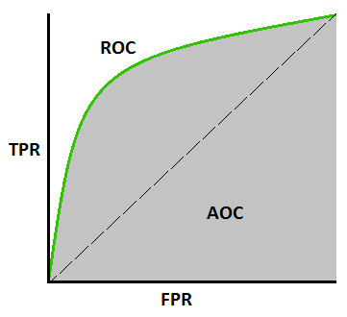
Type of Outlier Detection Methods
Soft vs Hard
Evaluation

Slide 6
Outlier Detection Approaches
Statistical-based Methods
Distance-based Methods

Slide 7
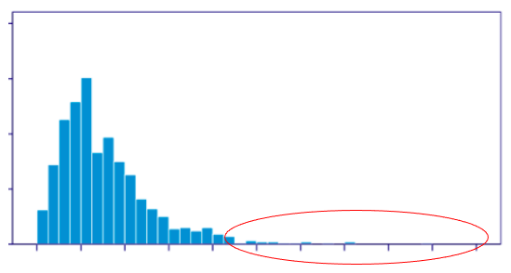
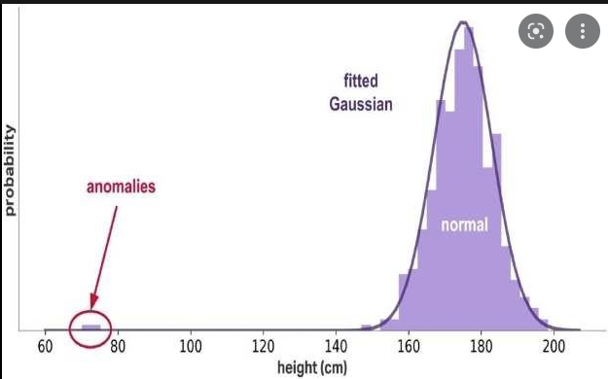
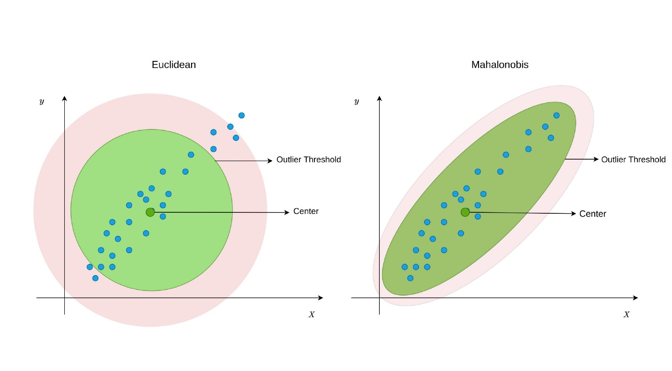
Statistical-based Methods
Low dimension

Slide 8
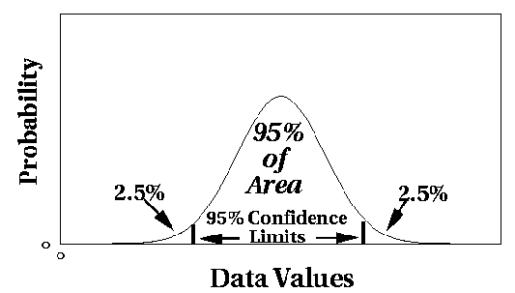
Statistical Approaches
Assume a parametric model describing the distribution of the data (e.g., normal distribution)
Apply a statistical test that depends on
Data distribution
Parameter of distribution (e.g., mean, variance)
Number of expected outliers (confidence limit)

Slide 9
Limitations of Statistical Approaches
Most of the tests are for a single attribute
In many cases, data distribution may not be known
For multi-dimensional data, it may be difficult to estimate the true distribution

Slide 10
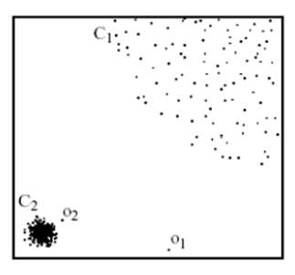
Distance-based Methods
Local Outlier Factor (LOF)

Slide 11
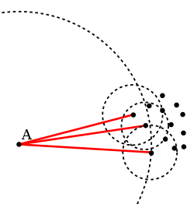


Distance-based Methods
LOF
local reachability density
reachability-distance_{k}(A,B)=max{k-distance(B), d(A,B)}

Slide 12
Distance-based Methods
LOF
Pros:
Due to the local approach, LOF is able to identify outliers in a data set that would not be outliers in another area of the data set
Cons:
High computation cost

Slide 13
Distance-based Methods
Cluster-based method
K-means--

Slide 14
Clustering with Outlier Removal
Liu, H., Li, J., Wu, Y., & Fu, Y. (2019).
IEEE transactions on knowledge and data engineering, 33(6), 2369-2379.

Slide 15

Clustering with Outlier Removal

Slide 16

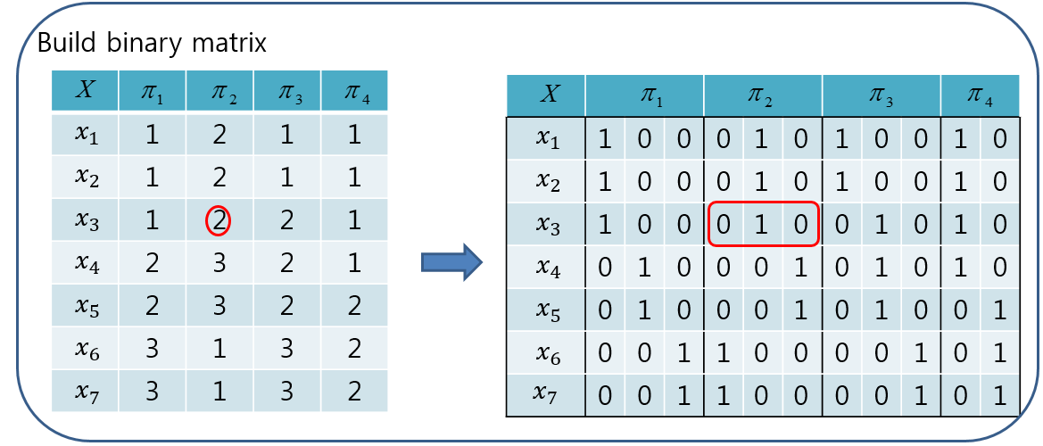
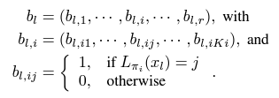
Clustering with Outlier Removal
Cluster-based objective function
the original space is transformed into the binary space via generating basic partitions in order to define clusters

Slide 17
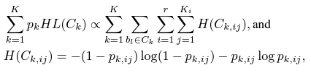
Clustering with Outlier Removal

Slide 18
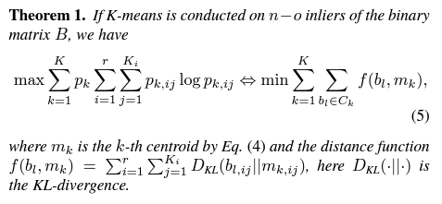
Clustering with Outlier Removal

Slide 19
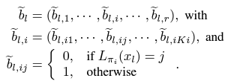
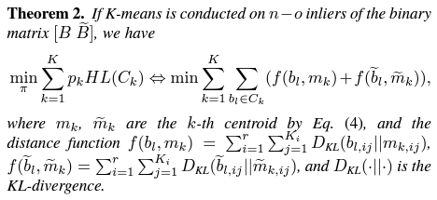
Clustering with Outlier Removal
We introduce another binary matrix as follows
Binary Flip

Slide 20
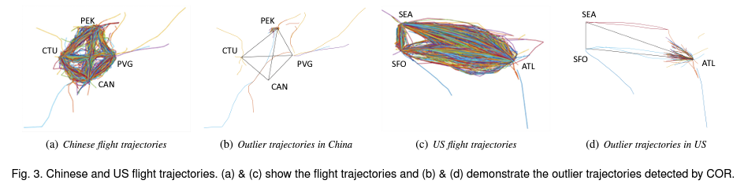
Clustering with Outlier Removal

Slide 21


